Slide 1

POSCO’s GHG Reduction Strategy
Korea’s Steel Industry
GHG Reduction Target for Korea and Steel Industry
Reduction Strategies of POSCO
Reduction Activities
Summary
2018. 6

Slide 2
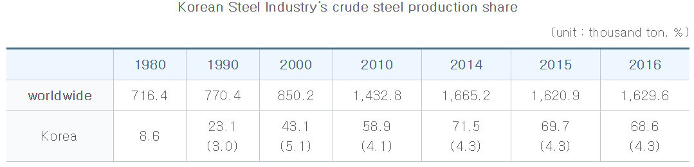
I. Korea’s steel Industry
Since the opening of POSCO in 1973,
Korea has become the world’s 6th largest steel producing nation in 2015
with 68.6 million tons
In 1970, Korea produced 0.1% of crude steel in the world and
the production increased to 3.0% in 1990, 5.1% in 2000 and 4.3% in 2016.
Worldsteel, ( ) shows the production share in the world. Korean Steel Industry’s crude steel production share
The per capita consumption of steel is also No. 1 in the world with 1,130kg in 2016 which exceeds 500kg of Germany, 493kg of Japan and 493kg of China

Slide 3
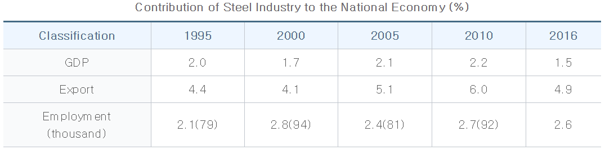
I. Korea’s steel Industry
The steel industry is the key industry with high impact on the inter-industries and has played a crucial role in the economic growth of Korea
by steadily providing materials
to demand industry such as automobile, shipbuilding and construction
The contribution of steel industry to the national economy is 1.5% of GDP and
4.9% of total export.
Data is based on employment in steel industry within the manufacturing industry in 2014
Data: the Bank of Korea, National Statistical Office, the Korea Development Bank, Korea International Trade Association

Slide 4
I. Korea’s steel Industry
Energy Consumption (2016)
GHGs Emission (2016)
Data is based on national energy balance of Korea Energy Economics Institute.
Transportation, Residential, Commercial, Public Sector’s consumptions are not included.
Non-energy use consumptions such as Naphtha are not included.
Data is based on Greenhouse Gas Inventory and Research Center database.

Slide 5




I. Korea’s steel Industry – POSCO at a glance
POSCO, the history of Korean steel industry built from literally "NOTHING"
Crude Steel Production (Domestic, Mt)
2017
40
○ Steel Production : Top 5th (37.5 Mt)
○ Products : Hot & Cold Coil, Stainless steel
○ Employees : 17,000
30
FINEX Commercialized
07
Privatized
00
NYSE Listed
94
20
Gwangyang
works
92
Evaluations
○ Global top 100 company by DAVOS
○ Best company for 13 yrs by Dow jones
○ Best company in steelmakers for 9 yrs
by *WSD
Pohang works
10
83
Foundation
68
*WSD : World steel dynamics
1970
1980
1990
2000
2016

Slide 6
II. GHG Reduction Target of Korea and Steel Industry
Reduction target by 2030
Key abatement options
in steel industry
’30 BAU
’30 target
851
(MtCO₂)
Nation
37%
(315)
Energy efficiency improvement
Fuel switch (heavy oil to LNG)
Operational efficiency improvement (e.g. FEMS*)
Waste heat recovery
Waste plastic injection
Breakthrough technologies (e.g. hydrogen reduction)
Steel industry adjustment and upgrade
536
481
Industry
11.7%
(56)
Industry
20.5%
(98)
425
153
Steel sector
11.1%
(17)
Steel Sector
??%
(??)
136
means the modified target for Power and Industry in 2018.06.28 and sectoral reduction targets are not announced yet.

Slide 7
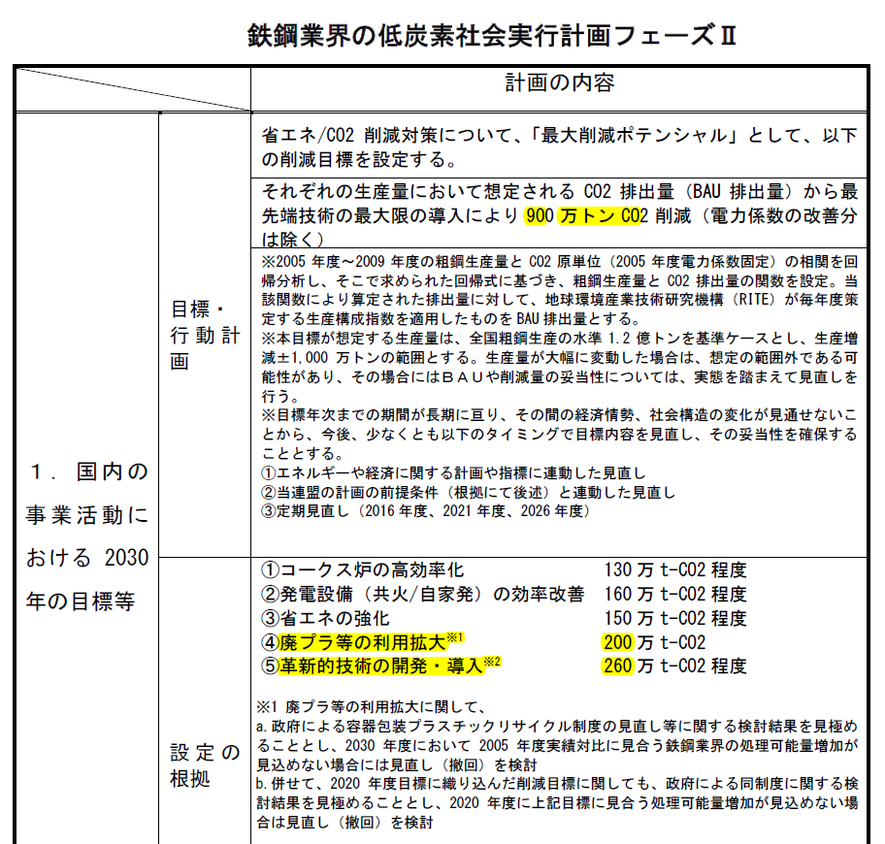
II. GHG Reduction Target of Korea and Steel Industry
Korea steel sector reduction target
Japan steel sector reduction target
’30 BAU
’30 target
’30 BAU
’30 target
153
183
174
Steel sector
11.1%
(17)
Steel sector
4.9%
(9)
136
Key abatement options
Energy efficiency improvement
Fuel switch (heavy oil to LNG)
Operational efficiency improvement (e.g. FEMS*)
Waste heat recovery
Waste plastic injection
Breakthrough technologies (e.g. hydrogen reduction)
Steel industry adjustment and upgrade
Need prior conditions
eg R&D cooperation etc

Slide 8
II. GHG Reduction Target of Korea and Steel Industry
2030 National target comparison between Korea and Japan
Unit : mil.tCO2eq
 |  | Korea |  |  | Japan
 |  | BAU | Reduction amount | Reduction rate | BAU | Reduction amount | Reduction rate
2030 National Target |  | 37% down below BAU |  |  | 26% down below emissions of 2013
Power |  | 333 333 | 64.5 140.5 | 19.4% 42.2% | 927 | 308 | 24.9%
Industry |  | 481 481 | 56.4 98.5 | 11.7% 20.5% | 401 | 28 | 6.5%
 | Steel | 153 | 17 | 11.1% | 183 | 9 | 4.9%
 | Chemical | 64 | 7 | 10.8% | 57 | 2 | 3.5%
 | Cement | 34 | 2.4 | 7.0% | 16 | 0.4 | 2.2%
 | Oil refinery | 23 | 2.1 | 9.5% | 38 | 2.7 | 7.0%
means the modified target for Power and Industry in 2018.06.28 and sectoral reduction targets are not announced yet.

Slide 9
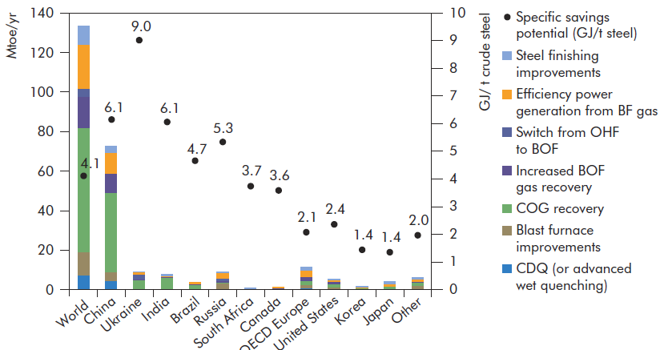
II. GHG Reduction Target of Korea and Steel Industry
Energy intensity in major steel producing countries
Korean steel industry has achieved the lowest energy intensity alongside Japan: limited CO₂ reduction potential
IEA (2008)
APP(2010)
RITE(2015)
Energy saving potential (GJ/t steel)
based on BATs
CO₂ reduction potential
based on BATs
Energy intensity (BF-BOF)
(Japan=100)
(Korea=100)
*APP(Asia Pacific Partnership on Clean Development and Climate), RITE(Research Institute of Innovative Technology for the Earth)

Slide 10
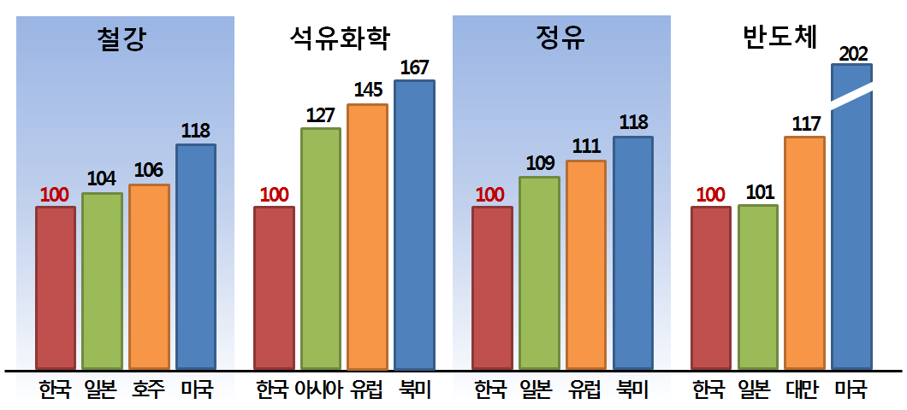
II. GHG Reduction Target of Korea and Steel Industry
Secotral energy efficiency comparison among Korea, Japan and the others
Steel
Chemical
Oil Refinery
Semiconductor
KOR
JPN
AUS
USA
KOR
Asia
EU
NA
KOR
JPN
EU
NA
KOR
JPN
TWN
USA
Source: APP Steel T/F, Solomon Study, Solomon Associates, World Semiconductor Council (2010)

Slide 11
III. Reduction Strategies of POSCO
POSCO’s GHG Reduction Targets and Strategies
POSCO’s Voluntary GHG Reduction Target by 2020
9% decrease from the average level between 2007 and 2009 (2.20 t-CO2/t-S)
Annual Emissions Target for the Korean ETS compliance
3P
Processes
Products
Procedures
(working procedures)
Efficiency Improvement
Waste heat recovery
Fuel & material switch
Breakthrough technology

Slide 12
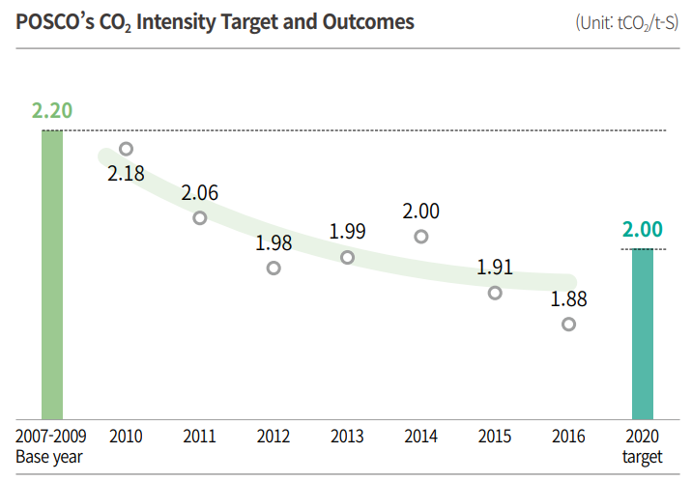
III. Reduction Strategies of POSCO
Process of the 3P
POSCO’s CO2 intensity target and outcomes
POSCO declared its GHG Reduction Target to be achieved by 2020 in February 2010
Reduce CO2 emissions per ton of steel in our steelworks to 2.00 t-CO2/t-S by 2020,
a 9% decrease from the average level between 2007 and 2009 (2.20 t-CO2/ t-S).
To achieve the goal, we are focusing
on decreasing coal consumption,
improving energy efficiency,
and developing innovative
CO2-reducing technologies.

Slide 13
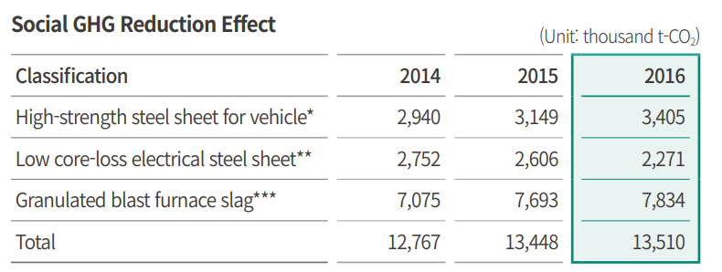
III. Reduction Strategies of POSCO
Product of the 3P
POSCO’s social GHG reduction effect
Social CO2 reduction effect is generated from the expansion of high energy-efficiency steel products such as high-strength steel sheet for automobile and low core-loss electrical steel that increases energy efficiency of motors and transformers.
In 2016, our social CO2 reduction effect amounted to 5.68 million tons.
Blast furnace slag, one of byproducts from steelmaking, contributed to reducing 7.83 million tons of CO2 by being used as an alternative of cement in 2016.

Slide 14










IV. Reduction Activities (focused on the process development)
Main facilities for energy saving
Iron making
Steel Making
Hot Rolling
Cold Rolling
Coal
Cokes oven
Converter
Hot Rolled
Cold Rolled
Steel
Products
Iron ore
Sinter plant
Power Generation
Lime stone
Blast Furnace
Lime
Calcination
(Outsourcing)
By-product Gas
Process | Iron Making |  |  | Steel making (Converter) | Rolling Furnace | Power Plant
 | Blast Furnace | Cokes Oven | Sinter Plant
Recovery Facility | TRT | CDQ | Cooler Boiler | OG Boiler | Recuperator | Heat Exchanger

Slide 15
IV. Reduction Activities
Energy Efficiency Improvement
Enhancement of power generation efficiency
Efficiency for power generation was increased from 37% to 45% by introducing combined cycle power plant for waste gas
Result in the increasement of 180 GWh/y and reduction of 80 ktCO₂/y.
Minimization of waste gas release to atmosphere
Sometimes lots of waste gases used to be released into atmosphere due to the extension of factories and repairing of power plant using waste gas
Result in the reduction of 160 ktCO₂/y
Evaporative cooling system
Resulted in annually increase of 300 kt steam, 80 GWh electricity and finally reduction of 38 ktCO₂
Low to mid-temperature waste heat power generation
600 KW standard module was installed in the sintering plant and developed through performance optimization and long-term operational test.

Slide 16
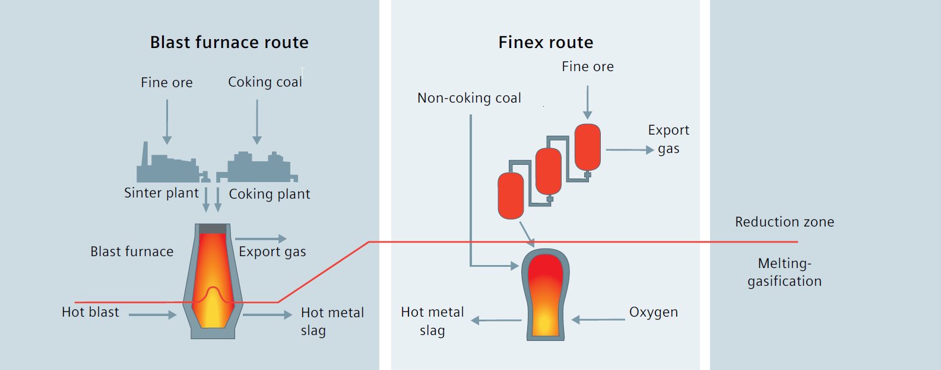
IV. Reduction Activities
CO₂ Breakthrough Technology
Blast Furnace Route
FINEX® Route
Reduction Zone
Melting Zone
Hot Air
O₂
High
Dust SO_{X} NO_{X}
Low
Hard
CO₂
Separation
Easy

Slide 17
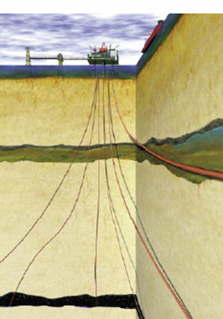
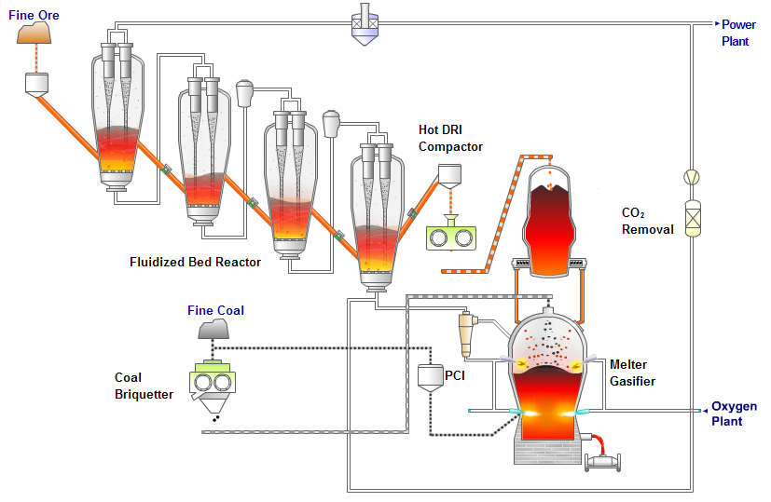
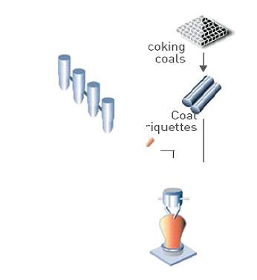
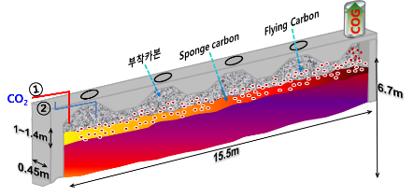
IV. Reduction Activities
CCS&U with FINEX off tail gas
FINEX boundry
Storage
Power Plant
Tail Gas
( > 70% of CO₂)
CO₂
Removal
Liquid CO₂
Utilization
Chemical Synthesis
Cryogenic CO₂
purification &
liquefaction
Utilization
in coke oven
(tested in demo plant)
CO₂ reduction potential of FINEX process
BF
(world average)
100
FINEX)
98
FINEX
(with CCS&U)
55

Slide 18
V. Summary
Over the past 30 years POSCO has placed a strong emphasis on improving
the energy efficiency of manufacturing processes and steel products --
indicating a very limited potential to reduce CO₂ with existing technologies
It will be difficult and expensive to reach 2030 emissions target and
impossible to achieve the deeper emission reductions without
breakthrough technologies thereafter.
By recognizing these challenges, POSCO is currently working on
company’s mid- to long-term strategies to cope with tightening carbon
regulations at home and abroad.
POSCO will continue to play a leadership role in addressing climate change
through the application of a number of innovative technologies to
our manufacturing processes.

